Slide 1
Introduktion til Programmering og Problemløsning (PoP)
Jon Sporring
Department of Computer Science
2020/09/07

Slide 2
Virkefelter (scope)
Navne (i yderste virkefelt) kan ikke overskrives
let name = "World"
let name = "Jon"
do printfn "Hello %s" name
name = "Jon" greeting = "Hello"
name = "Anders"
...
...
0
1
2
...
Virkefelter via parenteser
0
let greeting = "Hello"
let name = "Jon"
do printfn "%s %s" greeting name
(
let name = "Anders"
do printfn "%s %s" greeting name
)
do printfn "%s %s" greeting name
1

Slide 3
Syntaks og virkefelter
Letvægtssyntaks
verbose syntaks
let name = "World"
do printfn "Hello %A" name
let name = "World" in do printfn "Hello %A" name
Valgfrit ’do’
let name = "World"
printfn "Hello %A" name

Slide 4
Funktioner
Organisering = nemmere at forstå og vedligeholde
let greetings (name : string) : string =
"Hello " + name
> let greetings (name : string) : string =
- "Hello " + name;;
val greetings : name:string -> string
Leksikografisk virkefelt
Indryk angiver funktionskroppen
let greetings name =
"Hello " + name
let str = greetings "Jon"
printfn "%s" str
printfn "%s" (greetings "World")
let greetings name = "Hello " + name
let greetings name : string = "Hello " + name
let greetings (name : string) = "Hello " + name

Slide 5
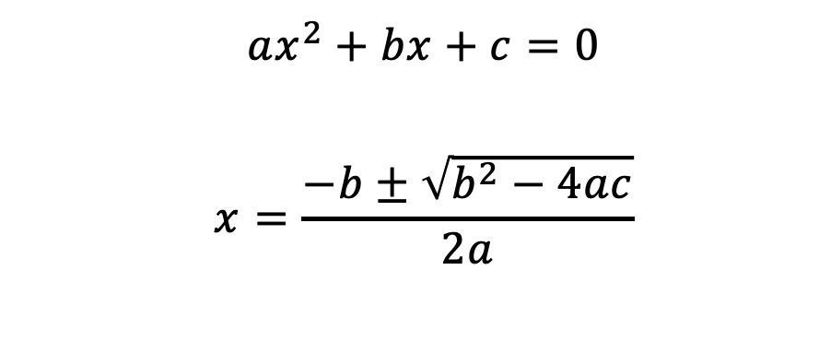
Løs en andengradsligning (baglæns!)
let discriminant a b c =
b ** 2.0 - 4.0 * a * c
let solution a b c sgn = -3.4
$${ax}^{2}+bx+c=0$$
$$x=\frac{−b±\sqrt{b^{2}−4ac}}{2a}$$
let solution a b c sgn =
let d = discriminant a b c
(-b + sgn * sqrt d) / (2.0 * a)
Mockup funktion
let a = 1.0
let b = 0.0
let c = -1.0
let xp = (solution a b c +1.0)
printfn "0 = %fx^2 + %fx + %f => x_+ = %f" a b c xp

Slide 6
Dokumentation - simpel
Summary felt efter dokumentationsstandarden
/// The discriminant of a quadratic equation with parameters a, b, and c
let discriminant a b c = b ** 2.0 - 4.0 * a * c // Note that F# will automatically typecast to float
(* This function needs to be tested! *)
Almindelig kommentarer udenfor dokumentationsstandarden

Slide 7
/// <summary>Find x when 0 = ax^2+bx+c.</summary>
/// <remarks>Negative discriminants are not checked.</remarks>
/// <example>
/// The following code:
/// <code>
/// let a = 1.0
/// let b = 0.0
/// let c = -1.0
/// let xp = (solution a b c +1.0)
/// printfn "0 = %.1fx^2 + %.1fx + %.1f => x_+ = %.1f" a b c xp
/// </code>
/// prints <c>0 = 1.0x^2 + 0.0x + -1.0 => x_+ = 0.7</c> to the console.
/// </example>
/// <param name="a">Quadratic coefficient.</param>
/// <param name="b">Linear coefficient.</param>
/// <param name="c">Constant coefficient.</param>
/// <param name="sgn">+1 or -1 determines the solution.</param>
/// <returns>The solution to x.</returns>
let solution a b c sgn =
let d = discriminant a b c
(-b + sgn * sqrt d) / (2.0 * a)
Dokumentation - grundig

Slide 8
XML dokumentationspipeline
mdoc update
commentExample.fsx
commentExample.xml
commentExampleHTML
index.html
fsharp --doc
mdoc export-html
fsharpc --doc:commentExample.xml commentExample.fsx
mdoc update -o commentExample -i commentExample.xml commentExample.exe
mdoc export-html -out commentExampleHTML commentExample

Slide 9
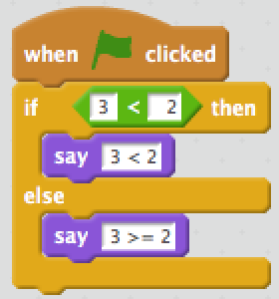
Betingelser
If-then-else
Kæde af betingelser
> if 3 < 2 then
- printfn "3 < 2"
- else
- printfn "3 >= 2";;
3 >= 2
val it : unit = ()
> let str =
- if 3 < 2 then
- "3 < 2"
- elif 3 = 2 then
- "3 = 2"
- else
- "3 > 2";;
val str : string = "3 > 2"
> let str =
- if 3 < 2 then
- "3 < 2"
- else
- "3 >= 2";;
val str : string = "3 >= 2"

Slide 10
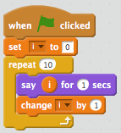
Muterbare værdier og løkker
let mutable x = 5
printfn "%d" x
x <- -3
printfn "%d" x
for i = 1 to 10 do
printf "%d " i
printfn ""
let mutable i = 1
while i <= 10 do
printf "%d " i
i <- i + 1
printf "\n"

Slide 11
Hvad gør programmet?
i på højre side er altid 0
let i = 0
while i < 3 do
let i = i + 1
printfn "%d" i

Slide 12
Venstre side af en binding kan have navngivne tuple-elementer
Tupler
$fsharpi
…
> let a = (1, 1.0);;
val a : int * float = (1, 1.0)
> let (b1, b2, b3) = b;;
val b3 : char = '1'
val b2 : string = "en"
val b1 : int = 1
Produkttype
Funktioner til at indicerer i par
Hele typen - ikke enkelt - elementer kan være mutérbare
> printfn "%A %A" (fst a) (snd a);;
1 1.0
val it : unit = ()
> let mutable c = (1,2)
- c <- (2,3)
- printfn "%A" c;;
(2, 3)
val mutable c : int * int = (2, 3)
val it : unit = ()
Parentes unødvendig men anbefalelses
> let b = 1, "en", '\049'
val b : int * string * char = (1, "en", '1’)

Slide 13
Decimal til Binær
let N = 116
let mutable n = N
let mutable str = ""
while n > 0 do
let rest = n % 2
n <- n / 2
if rest > 0 then
str <- "1"+str
else
str <- "0"+str
printfn "%d_10 = %s_2" N str
let N = 116
let mutable n = N
let mutable str = ""
while n > 0 do
str <- (if n % 2 > 0 then "1" else "0") + str
n <- n / 2
printfn "%d_10 = %s_2" N str

Slide 14
Resumé
I denne video hørte du om:

